Slide 1
Course Title: Engineering Chemistry-1
Course Code: CHE109
(Chapter 2)
Dr. Joyanta Kumar Saha
Associate Professor
Department of Chemistry
Jagannath University

Slide 2
Acids and bases
Arrhenius concept: According to Arrhenius, an acid is any substance that can increase the concentration of hydrogen ions in aqueous solution. A base is a substance that can increase the concentration of hydroxyl ions in aqueous solution.
HCl+H₂O -→ H₃O⁺ + Cl⁻
NaOH + H₂O -→ Na⁺ + OH⁻
The hydrogen ions in aqueous solutions are ectensively hydrated forming a hydrated proton, H₃O⁺, called hydronium ion. H⁺ is less stable.
BrΦnsted-Lowry concept of acids and bases: An acid is a substance that is able to donate a proton to other substance. A base is a substance that can accept a proton from an acid. HCl+H₂O -→ H₃O⁺ + Cl⁻
acid base acid base

Slide 3
When two substances are related to one another by the loss and gain of a single proton are called conjugate acid-base pair. In above reaction, HCl/Cl⁻ and H₃O⁺, H₂O are conjugate acid-base pairs.
There are many molecules and ions which can behave as acids in one instance and can function as bases in the other. Such substances are called amphiprotic. H₂O, NH₃, HSO₄⁻.
HCl+H₂O -→ H₃O⁺ + Cl⁻
base
H₂O+ NH₃ → NH₄⁺ + OH⁻
^{acid}

Slide 4
Relative strength of acids and bases: The strength of an acid is determined by its tendency to give up a proton and the strength of a base is determined by its tendency to accept a proton. A strong acid has a strong tendency to donate H⁺ and base has a strong tendency to accept a proton. HClO₄, HCl, H₂SO₄ and HNO₃ are completely ionized, i.e. the reactions in which they donate protons to water proceed to almost completion. These acids are relatively strong.
However, water solution of acetic acid, formic acid, hydrocyanic acid are partially ionized. They tend to donate protons to water only to a limited extent. Such acids are relatively weak.

Slide 6
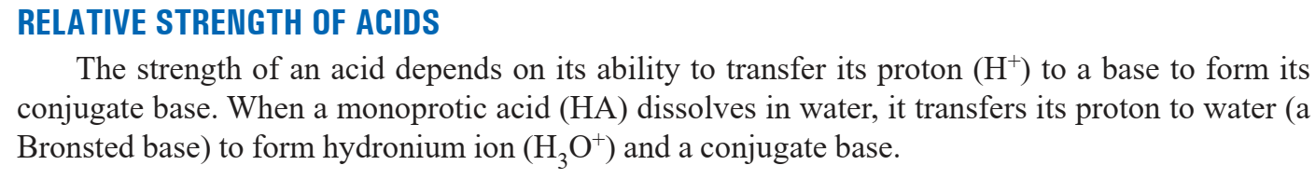
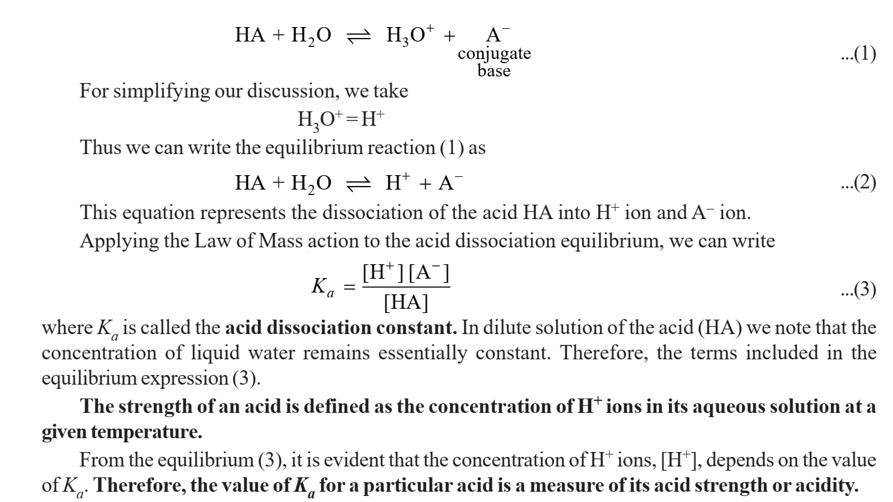

Slide 8
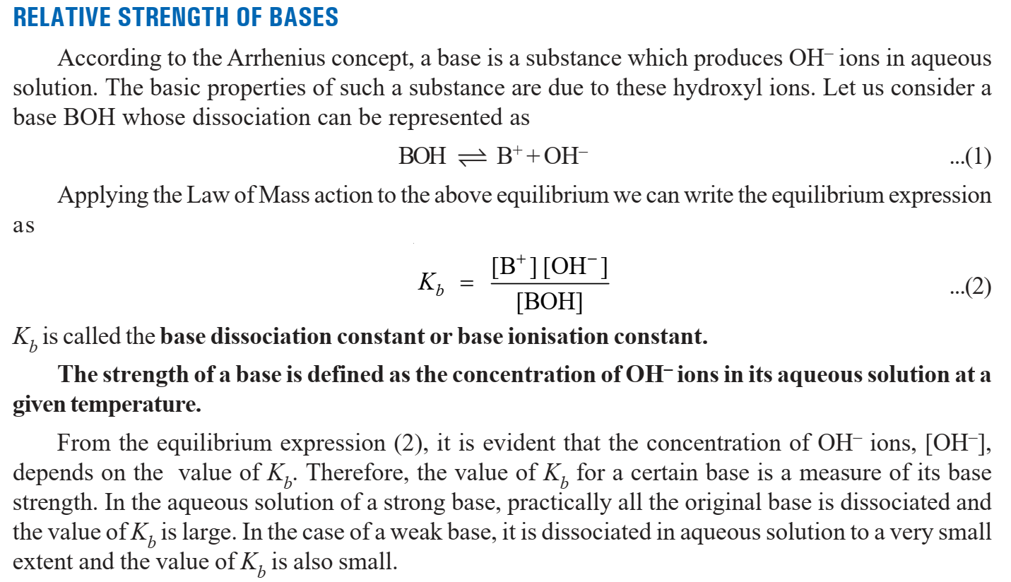

Slide 9
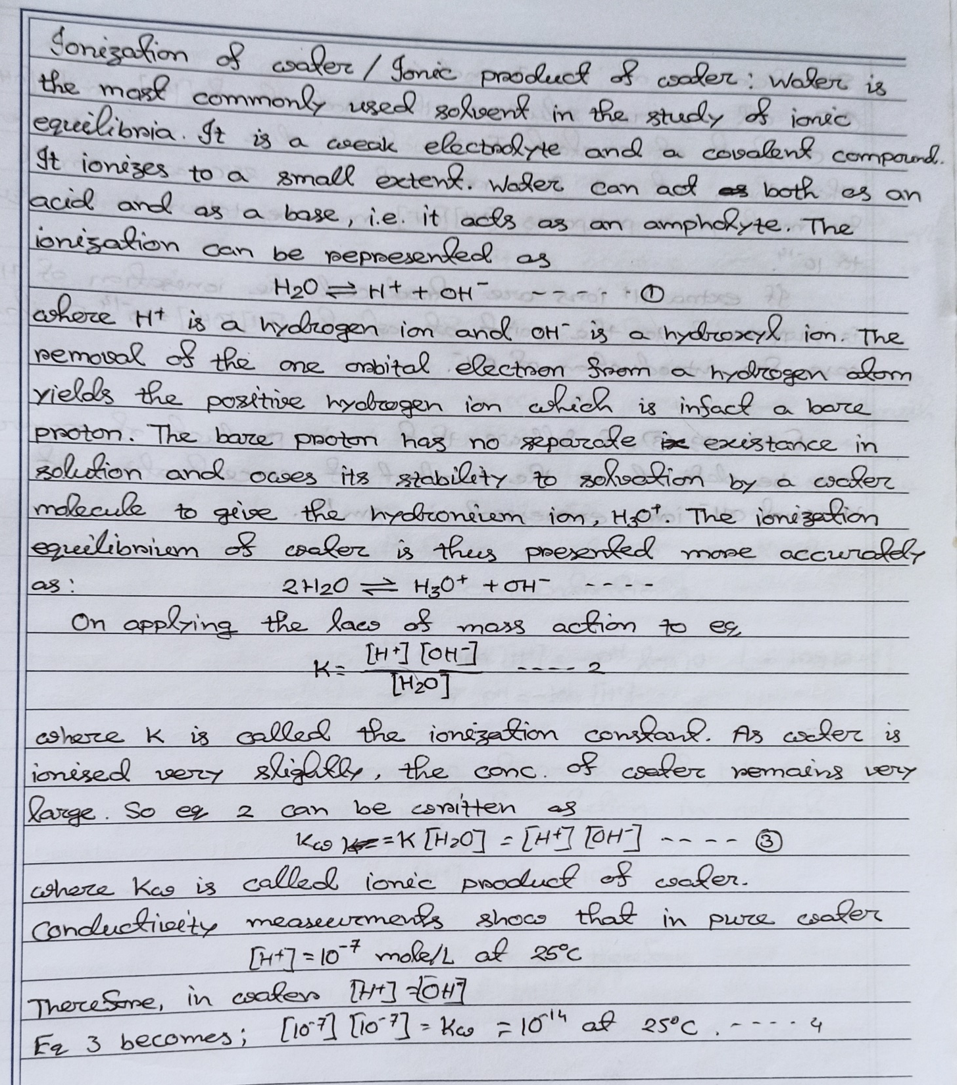
Ionization of water

Slide 10
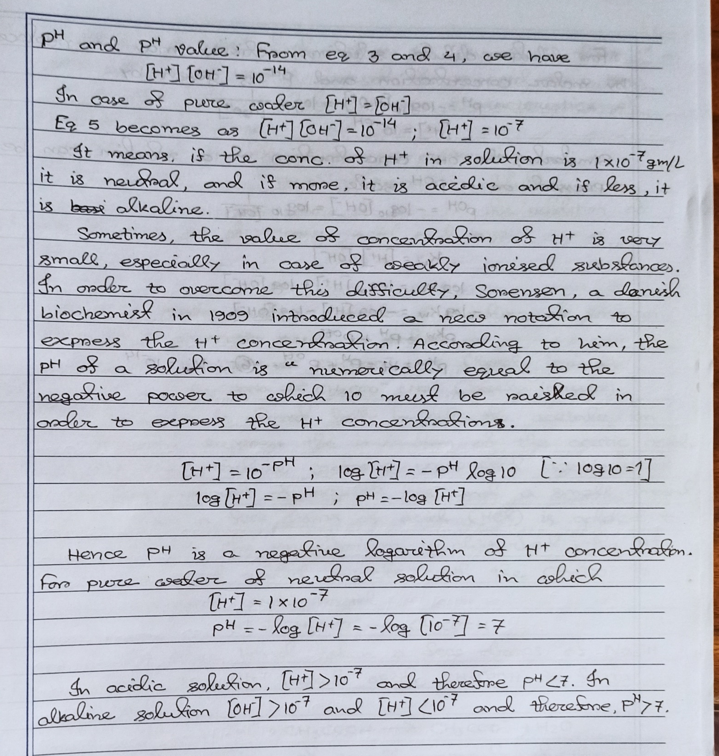
p^{H} concept

Slide 11
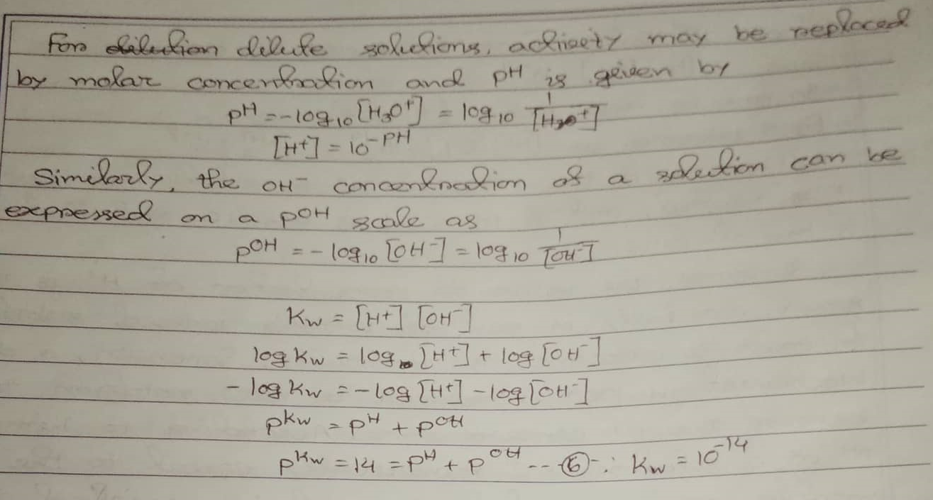

Slide 12
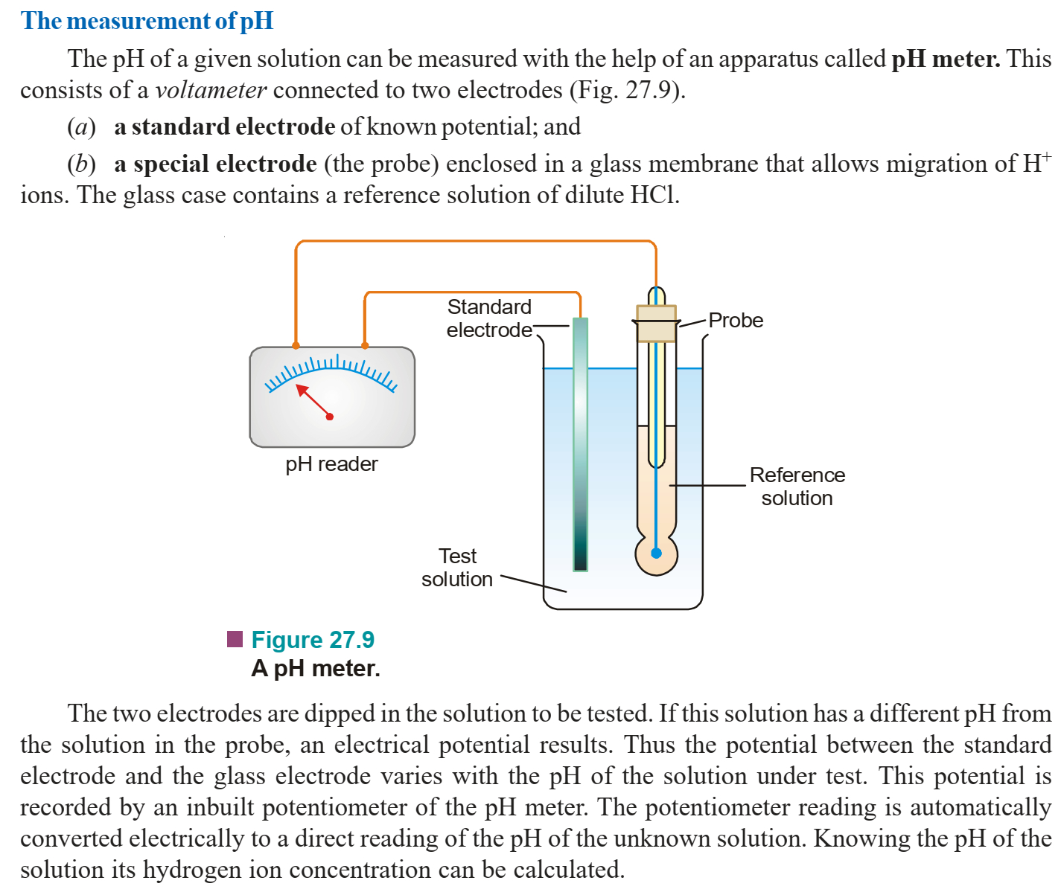

Slide 13
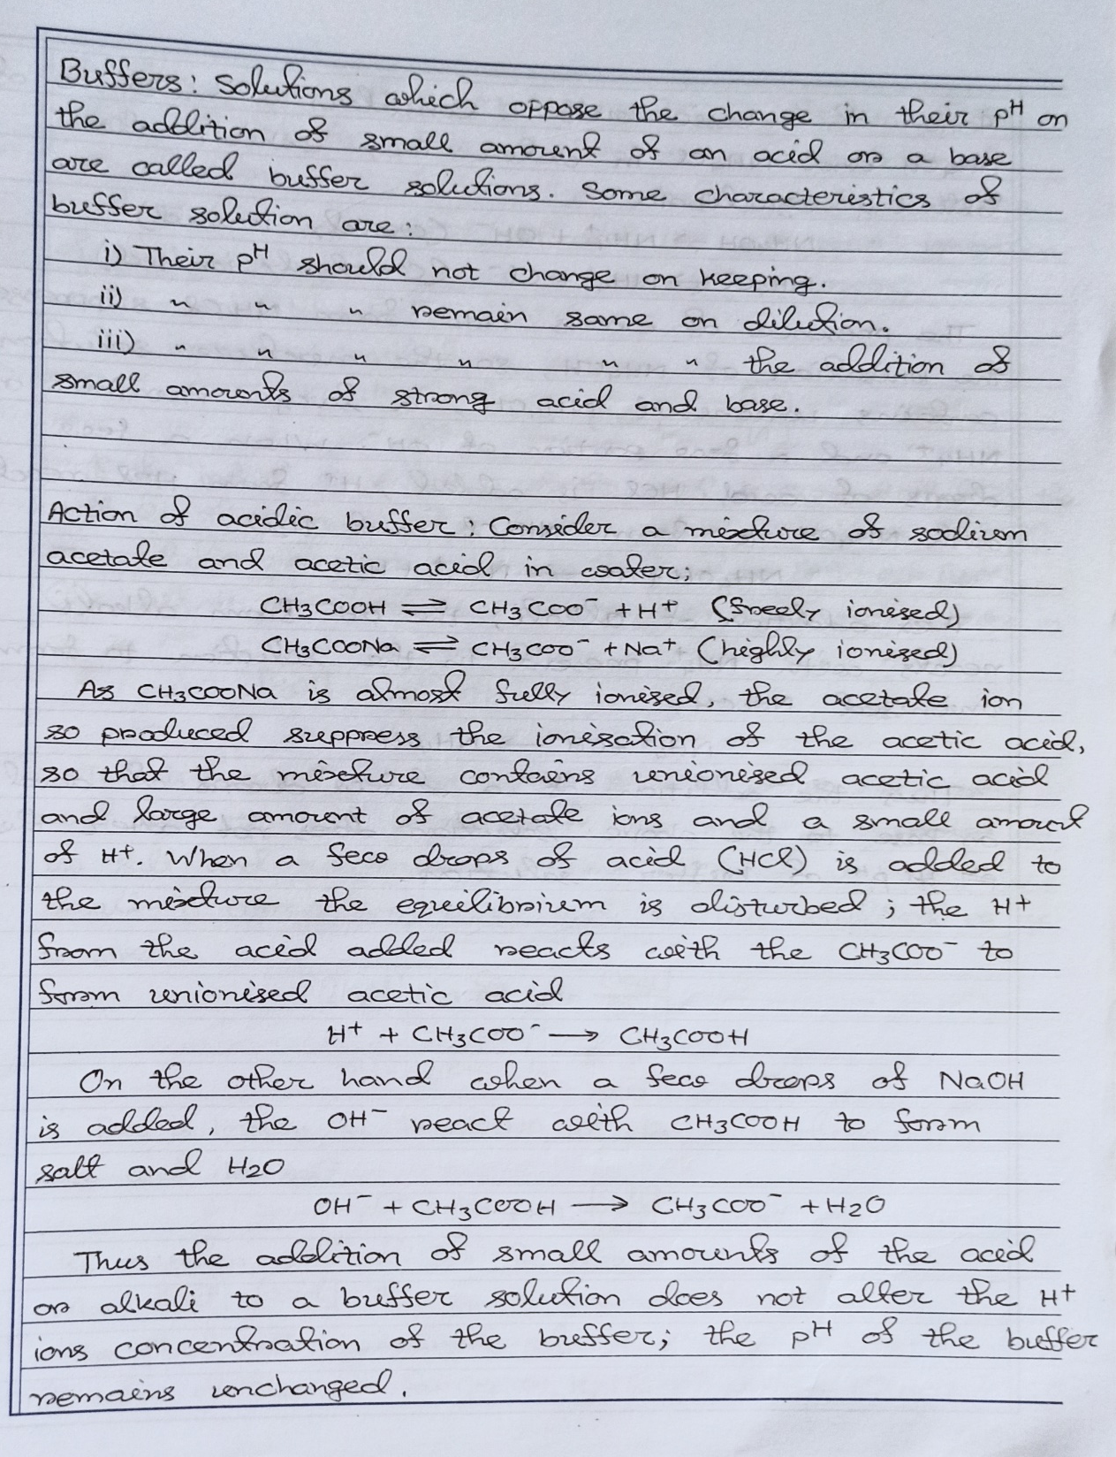
Buffer solution

Slide 14
ACID–BASE INDICATORS: An acid-base indicator is an organic dye that signals the end-point by a visual change in colour.
pH range of indicators Most indicators do not change colour at a particular pH. They do so over a range of pH from two to three units. This is called the pH range which is different for various indicators. TABLE 27.5. pH RANGES OF SOME ACID-BASE INDICATORS Indicator Colour change pH range (acid-base) Methyl orange red-orange → 3.1 – 4.4 Methyl red red-yellow → 4.4 – 6.0 Litmus red-blue → 5.0 –8.0 Bromothymol blue yellow-blue → 6.0 – 7.6 Phenolphthalein colourless-pink → 8.3 – 10.0

